Slide 1
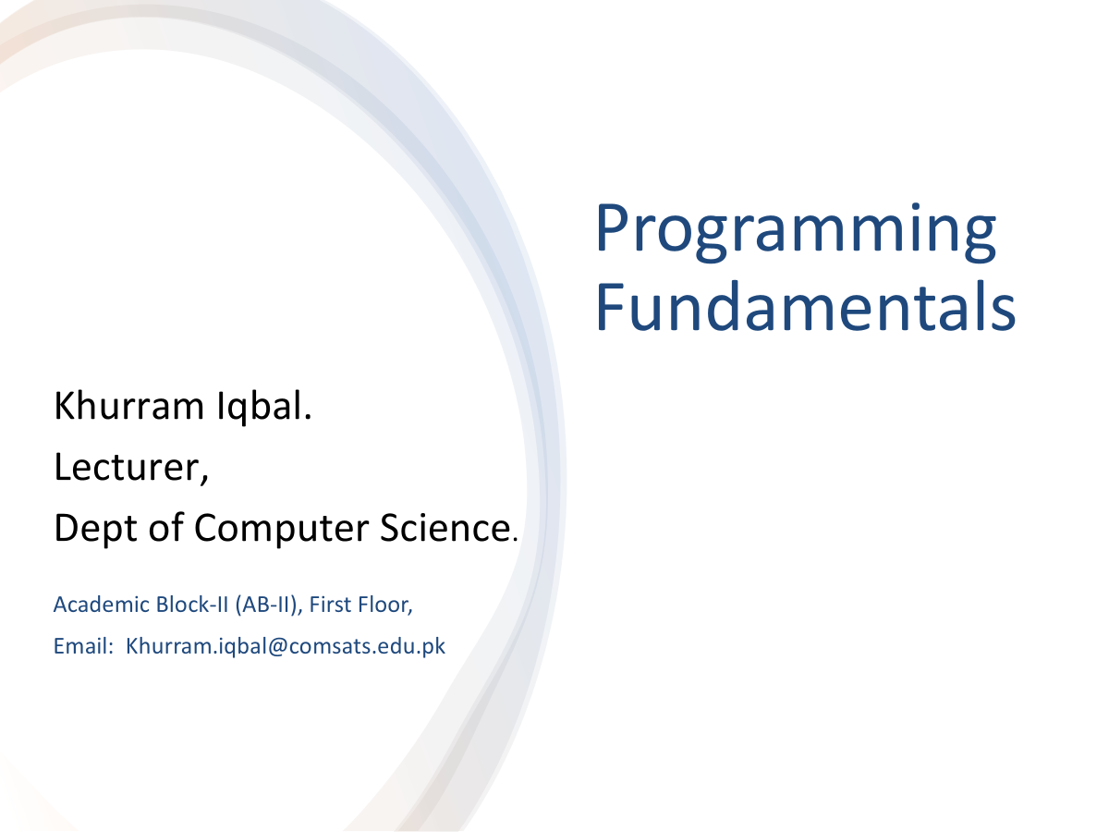

Slide 2
Lecture Outline
Java Primitive Data Types
Literals – Numeric Literals
Assignment Statement and Assignment Expression
Augmented Assignment Operators
Type Casting
Class String

Slide 3
Data Types
Primitive Data Type
Integral
Floating-point
Boolean
char
byte
short
int
long

Slide 4
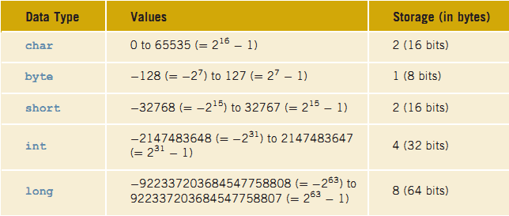
Integral Data Types

Slide 5
boolean Data Types
Two values: true and false (called Logical values)

Slide 6
Floating-Point Data Types
Type | Range | Storage | Precision
float | -3 .4E+38 and 3.4E+38 | 4 bytes | Single
double | -1.7E+308 and 1.7E+308 | 8 bytes | Double
To deal with decimal numbers

Slide 7
Literals
A literal is the source code representation of a fixed value
Example
Literals
Integer Literals
Floating-Point Literals
boolean result = true;
char capitalC = 'C';
byte b = 100;
short s = 10000;
int i = 100000;

Slide 8
Integer Literals
An integer literal is assumed to be of the int type, whose value is between
-2³¹( -2147483648) and 2³¹ - 1 (2147483647)
Integer literal of the long type, append the letter L or l to it
Integer literals can be expressed by these number systems
Decimal
Hexadecimal
Binary
octal
int viewCount = 2147483647
long viewCount = 2147483648L
int dec = 26; //Decimal Number System
int hexa = 0X1A; //0x or 0X Number System
int bin = 0b11010; //0b or 0B
int oct = 032; //0

Slide 9
Floating-Point Literals
By default, a floating-point literal is treated as a double type value
Append the letter f or F to make it float
Append the letter d or D to make it double
Scientific Notation
The floating point types (float and double) can also be expressed using E or e: a * 10^{b}

Slide 10
Using Underscore Characters in Numeric Literals
In Java SE 7 and later , any number of underscore characters (_) can appear any where between digits in a numerical literal
long creditCardNumber = 1234_5678_9012_3456L;
long socialSecurityNumber = 999_99_9999L;

Slide 11
Assignment Statements and Assignment Expressions
An assignment statement designates a value for a variable and an assignment statement can be used as an expression in Java
Syntax for Assignment Statement
An expression represents a computation involving values, variables, and operators that, taking them together, evaluates to a value.
variable = expression;
int y = 1; // Assign 1 to variable y
int x = 5 * (3 / 2); // Assign the value of the expression to x
x = y + 1; // Assign the addition of y and 1 to x

Slide 12
Numeric Operators

Slide 13
Integer Division
For Integer Division
5 / 2 yields an integer 2
To perform a float-point division, one of the operands must be a floating-point number
5.0 / 2 yields a double value 2.5
For Remainder
5 % 2 yields 1

Slide 14
Arithmetic Expressions
is translated to
(3+4*x)/5 – 10*(y-5)*(a+b+c)/x + 9*(4/x + (9+x)/y)

Slide 15
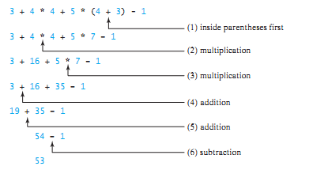
How to Evaluate an Expression
.
You can safely apply the arithmetic rule for evaluating a Java expression
*,/,%
+,-

Slide 16
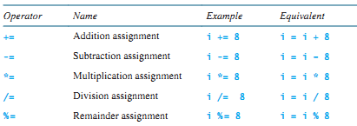
Augmented Assignment Operators
The operators +, -, *, /, and % can be combined with the assignment operator to form augmented operators.
Example
x /= 4 + 5.5 * 1.5;
is same as
x = x / (4 + 5.5 * 1.5);

Slide 17
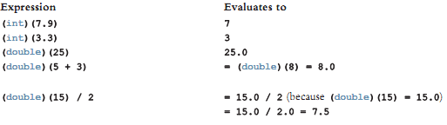
Numeric Type Conversions
Implicit Casting: Done automatically by Java (mixed expression)
Explicit Casting: Done by programmer
(dataTypeName) expression

Slide 18
class String
A string is a sequence of characters.
The char type represents only one character
String Type is use to represent collection of characters
String message = "Welcome to Java";
class String is a predefined class in the Java library (java.lang)
The String type is not a primitive type

Slide 19
class String
A string that contains no characters is called a null or empty string
Examples
“William Jacob”
“Mickey”
“”
Syntax
String variableName = “Some String”;
Character String
String literal
String constant

